Slide 1


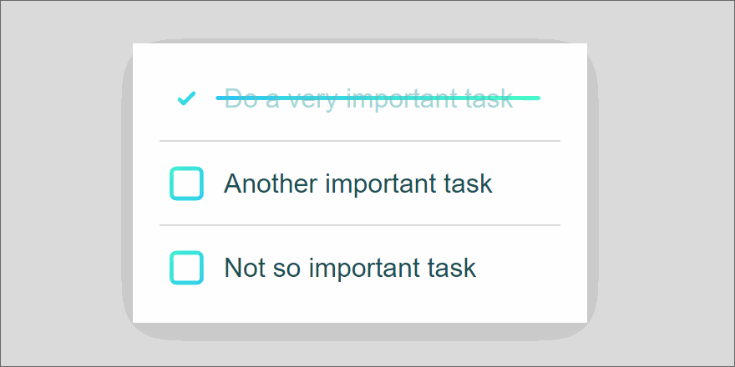
Cloud-Based Productivity Web Application
By: Aditi Patil | Ankita Kulkarni | Anjali Iyer | Shraddha Yadav

Slide 2

AGENDA
Introduction
App Features
Technologies Used
Progress Plan
Application Screenshots
Console Screenshots
Live Demo
Team’s Individual Contribution
Future Scope

Slide 3

INTRODUCTION
We have been forced to stay at home and practice social distancing in an effort to “flatten the curve”, so to speed, and reduce the spread of the coronavirus.
This has led to a “work-from-home” system, where the working class no longer needs to commute to and from work. There are many benefits to the work-from-home system, such as virtually no commute time and increased family interaction.
However, there are certain drawbacks as well, such as loss of productivity and increased procrastination.
So to help improve the situation to an extent possible we decided to create a cloud based web application that will help us manage our time and keep up with us during these unprecedented times.

Slide 4
Cloud-Based Productivity Web Application
This web application can be run on any device with supports a standard http browser and few key features of this
application would be-
Allows creating new account using email address and phone number
Allows user sign in and authentication using Cognito
Reset password
Create a new task
Edit a task
Delete a task
View all, pending & completed tasks

Slide 5

Technologies Used: Front End
React.js:
We selected React.js platform. ReactJS is a JavaScript library used to create UI components that can be reused. I helps us design user interfaces that are composable. Lots of people in MVC use Respond as the View.
Offering a simpler programming model and better results, React abstracts the DOM from you. React can also render using Node on the server, and using React Native, it can control native apps as well. It provides one-way reactive data flow, reducing the boilerplate and making it simpler to reason than standard data binding.

Slide 6




Cloud Technologies
Amplify: AWS Amplify is an end-to-end solution that enables mobile and front-end web developers to build and deploy secure, scalable full stack applications, powered by AWS.
Cognito: We are using Amazon Cognito as our user authentication service. It lets us add user sign-up, sign-in, and access control to your web and mobile apps quickly and easily.
GraphQL: GraphQL is a language for APIs that enables you to query and manipulate data easily through an intuitive and flexible syntax.
DynamoDB: And lastly we went with Dynamodb as our storage service since it is Fast and flexible NoSQL database service for any scale.

Slide 7
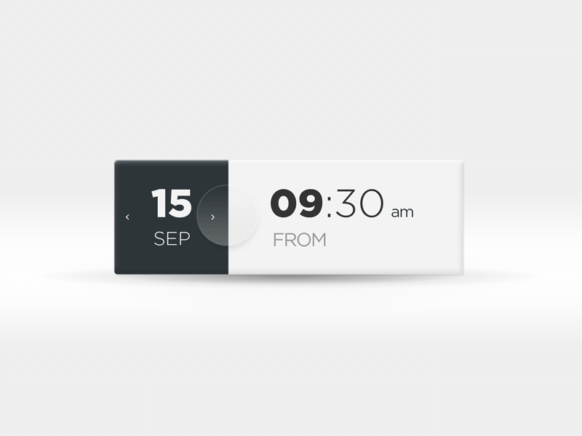

PROGRESS PLAN
Weeks | Milestones of the week towards final deliverables
Week 1 | Project topic selection. Language selection for the application.
Week 2 | Getting Familiar with React.js.
Week 3 | Getting Familiar with AWS services (Simple Email Service, Cognito, DynamoDb, GraphQL and Amplify).
Week 4 | Implementing theoretical knowledge gained by developing a mini-project on React.js and AWS
Week 5 | Backend development.

Slide 8

Weeks | Milestones of the week towards final deliverables
Week 6 | Backend development.
Week 7 | Frontend development
Week 8 | Integration of the Frontend with the Backend
Week 9 | Hosting application on AWS
Week 10 | Testing the application for bugs and errors

Slide 9
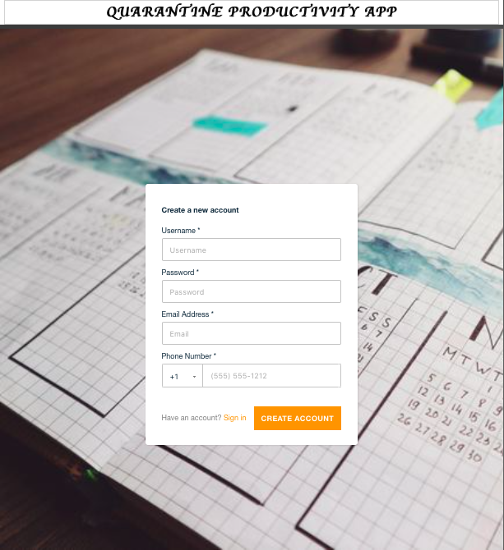
Application Screenshots
1. Create New User Page

Slide 10
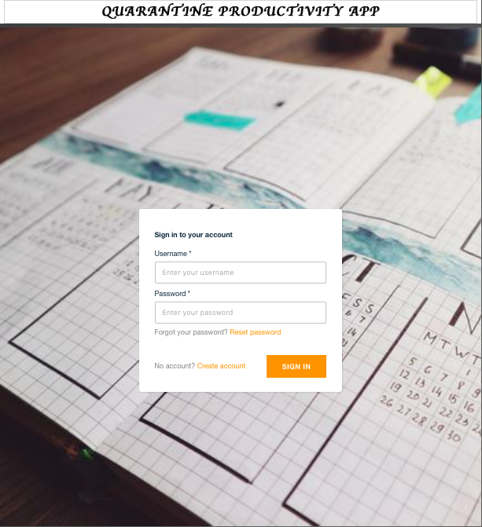
2. App Sign In Page

Slide 11
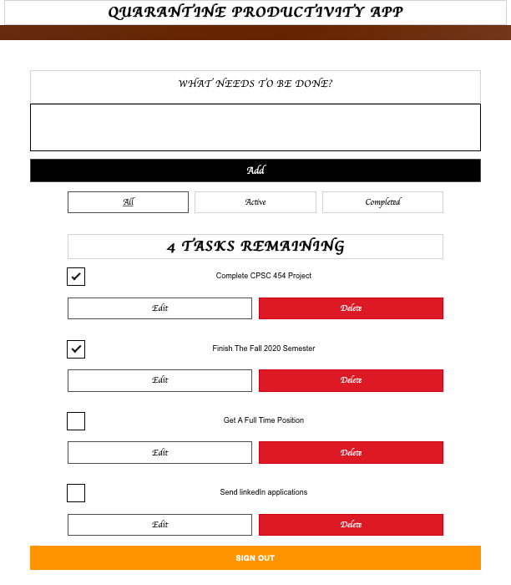
3. To-Do List Page with Sign Out Button

Slide 12
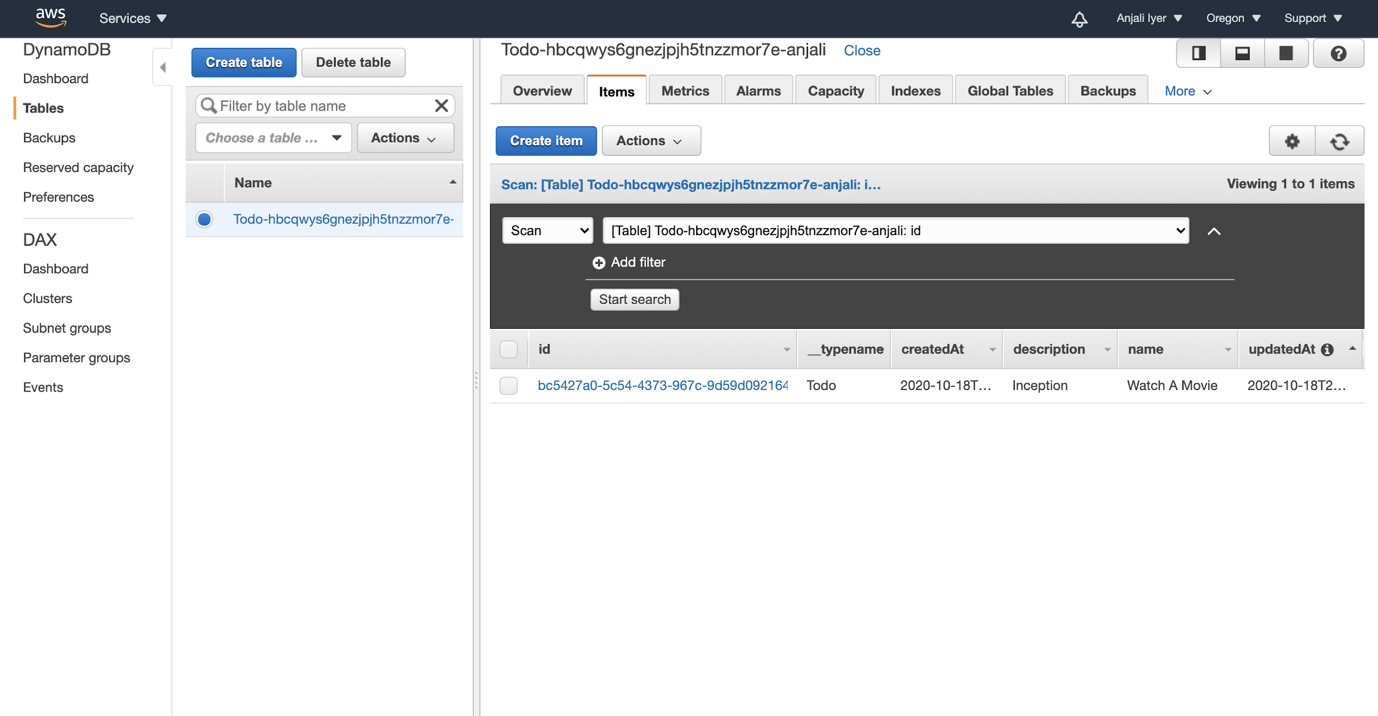
AWS DynamoDB Console - Table Storing To Do List Information

Slide 13
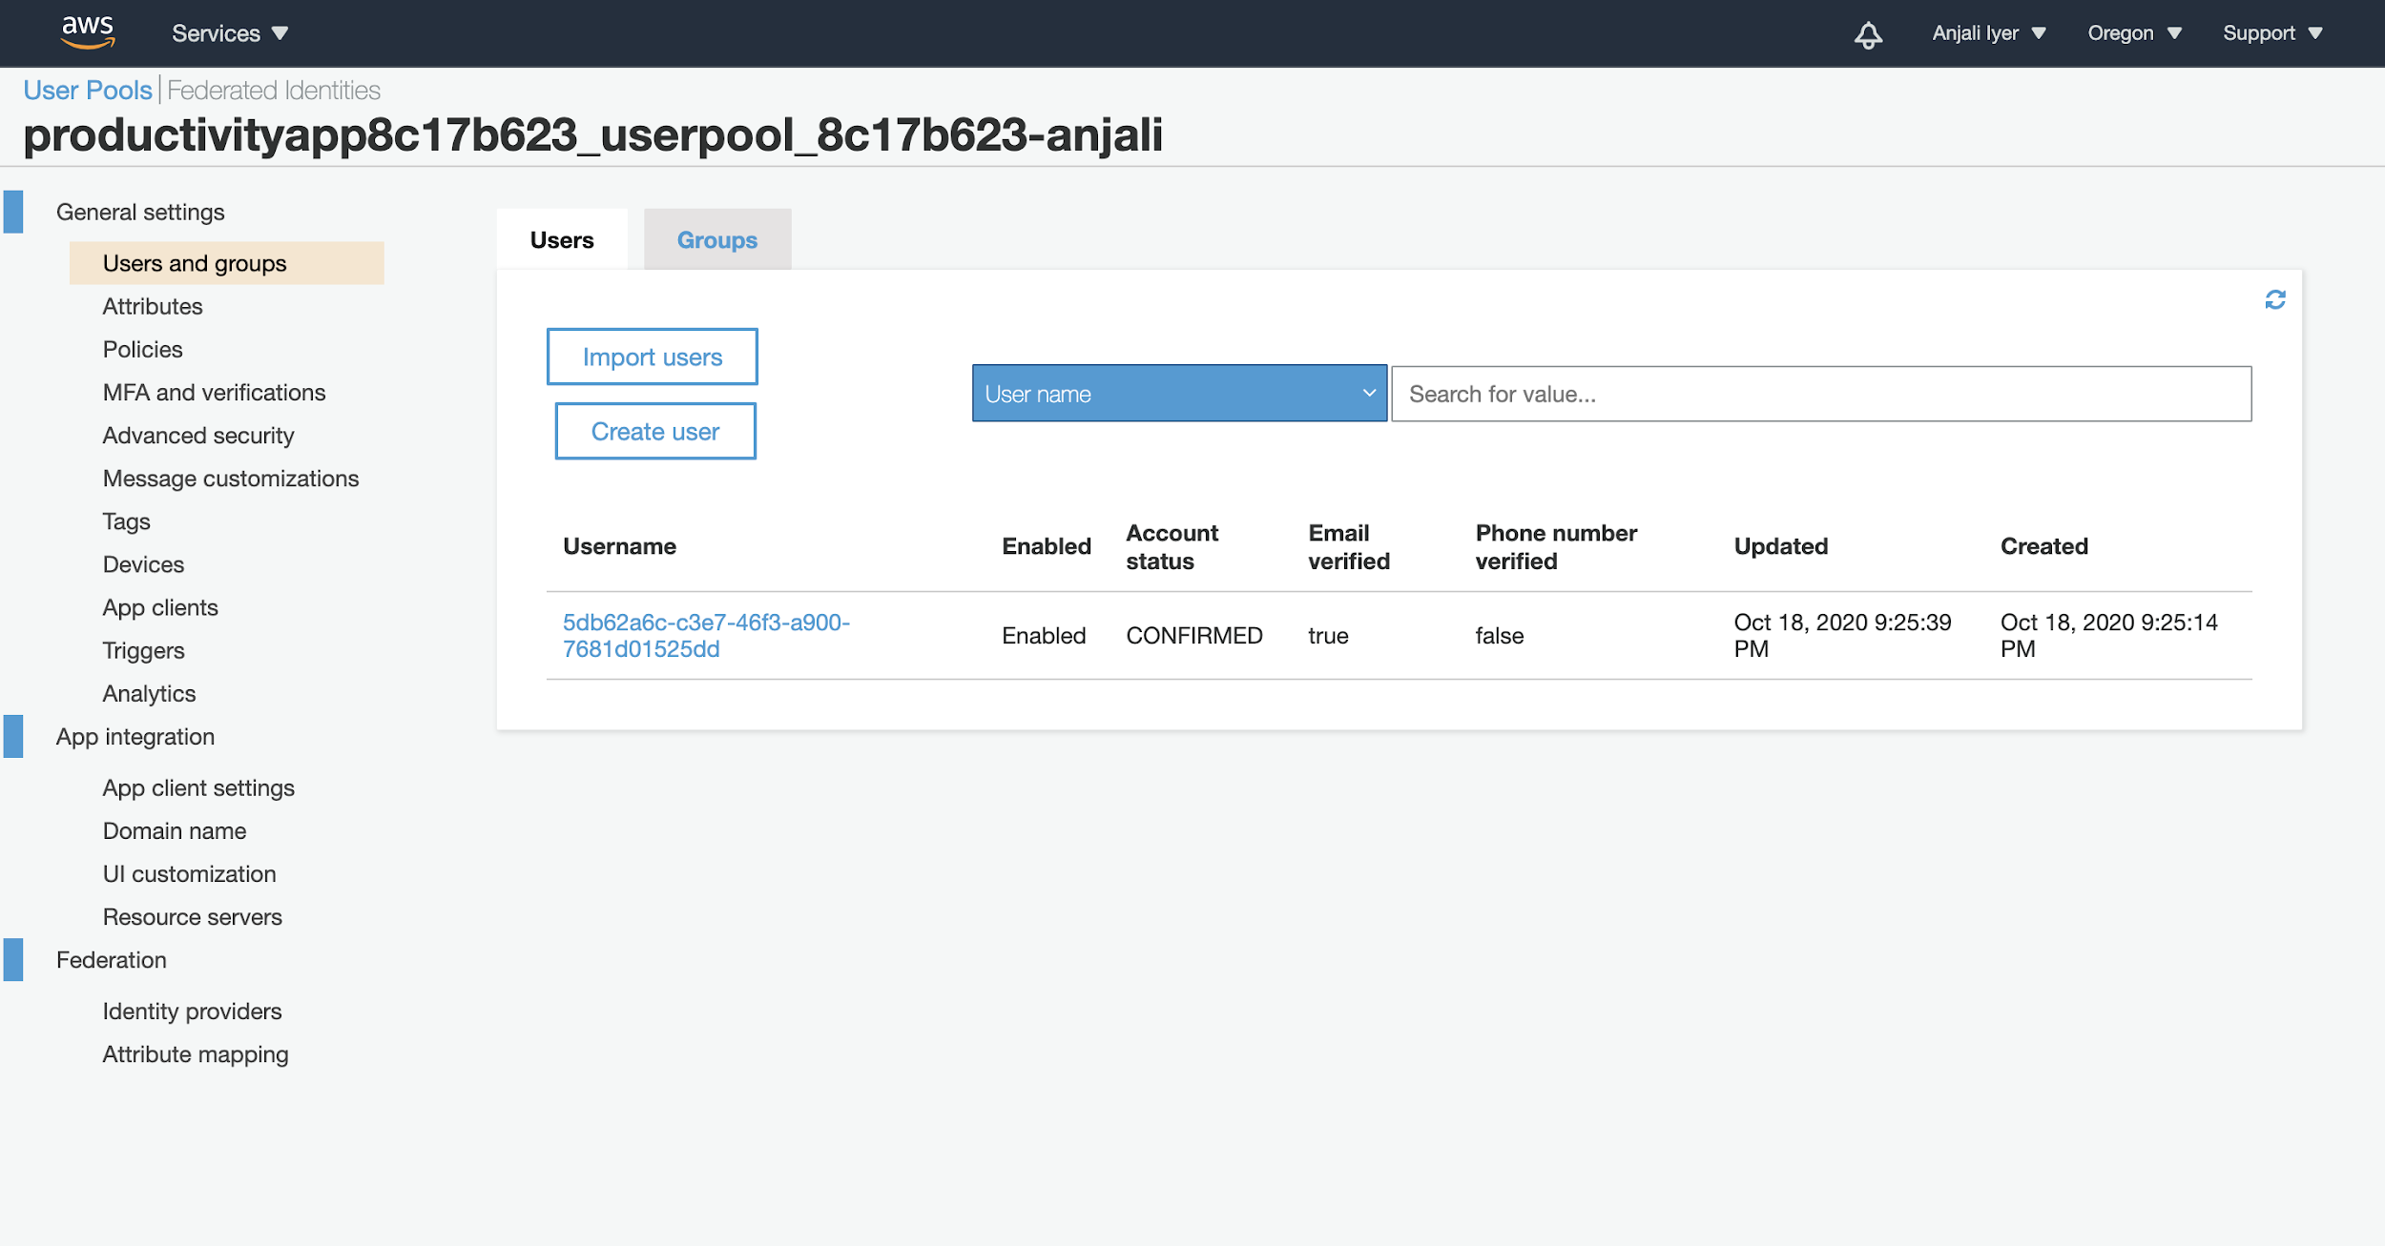
AWS Cognito Console - User Pool Containing Registered User Information

Slide 14
Live Demo

Slide 15
Team’s Individual Contribution
Ankita Kulkarni - Backend Development using different Amazon web services like Cognito, Amplify and DynamoDB.
Aditi Patil - Front-End Development using React.js, JavaScript, HTML and CSS.
Anjali Iyer - Integration of the front-end and the back-end to ensure seamless integration and web app functionality, and running basic tests on the web application.
Shraddha Yadav - Backend Development using different Amazon web services like Amplify and GraphQL.

Slide 16
Future Scope
Developing a React Native App for iOS and Android based devices.
We can add Machine Learning Libraries to auto suggest users tasks that are added repeatedly, at regular intervals.
We can add a reminder for a task so that the user gets an email and a push notification about the task.
We can integrate this application with third party applications like Google Calendar or iCal for seamless access.
Sorting the task according to the priorities, high, medium and low.

Slide 17
LINKS
Recorded Presentation - https://fullerton.zoom.us/rec/share/DfTJ4rZEsvKH2NBHg0bmChQVUdcxALtZSB2Fl94T-dY5KqFd_2sLNAE87zjri48x.BTsImraxfcg5DRbG?startTime=1608489439000
Password: yQ*q7AwB
Project Link - https://anjali.d352s8xgghpe8t.amplifyapp.com/
IEEE format Paper - https://drive.google.com/file/d/13QS4lCs21s_-r0pdewl9gysoDPMR2TXq/view?usp=sharing

Slide 18
THANK YOU

